Slide 1
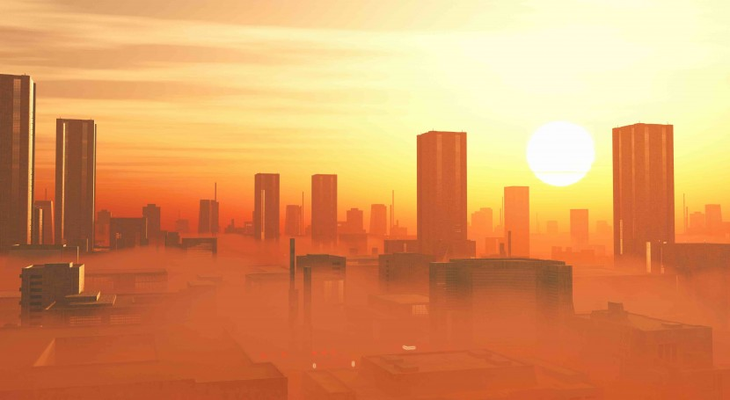

GEO-SPACIAL TRACK
URBAN HEAT ISLAND EFFECT
S BHADRA / ANUSREE / AKHIL DEV M S / RAJATH VISWAM

Slide 2
TABLE OF CONTENTS
Datasets Used
What is an Urban Heat Island
Causes of UHI
Effects of UHI
Locations considered for analysis
Key parameters to consider
Surface Temperature
Vegetation Cover
Built Up Index
Air Quality
Conclusion

Slide 3
DATASETS USED
FAO GAUL 500m: Global Administrative Unit Layers 2015, Second-Level Administrative Units
USGS Landsat 7 Collection 2 Tier 1 and Real-Time data Raw Scenes
MOD11A1.061 Terra Land Surface Temperature and Emissivity Daily Global 1km

Slide 4


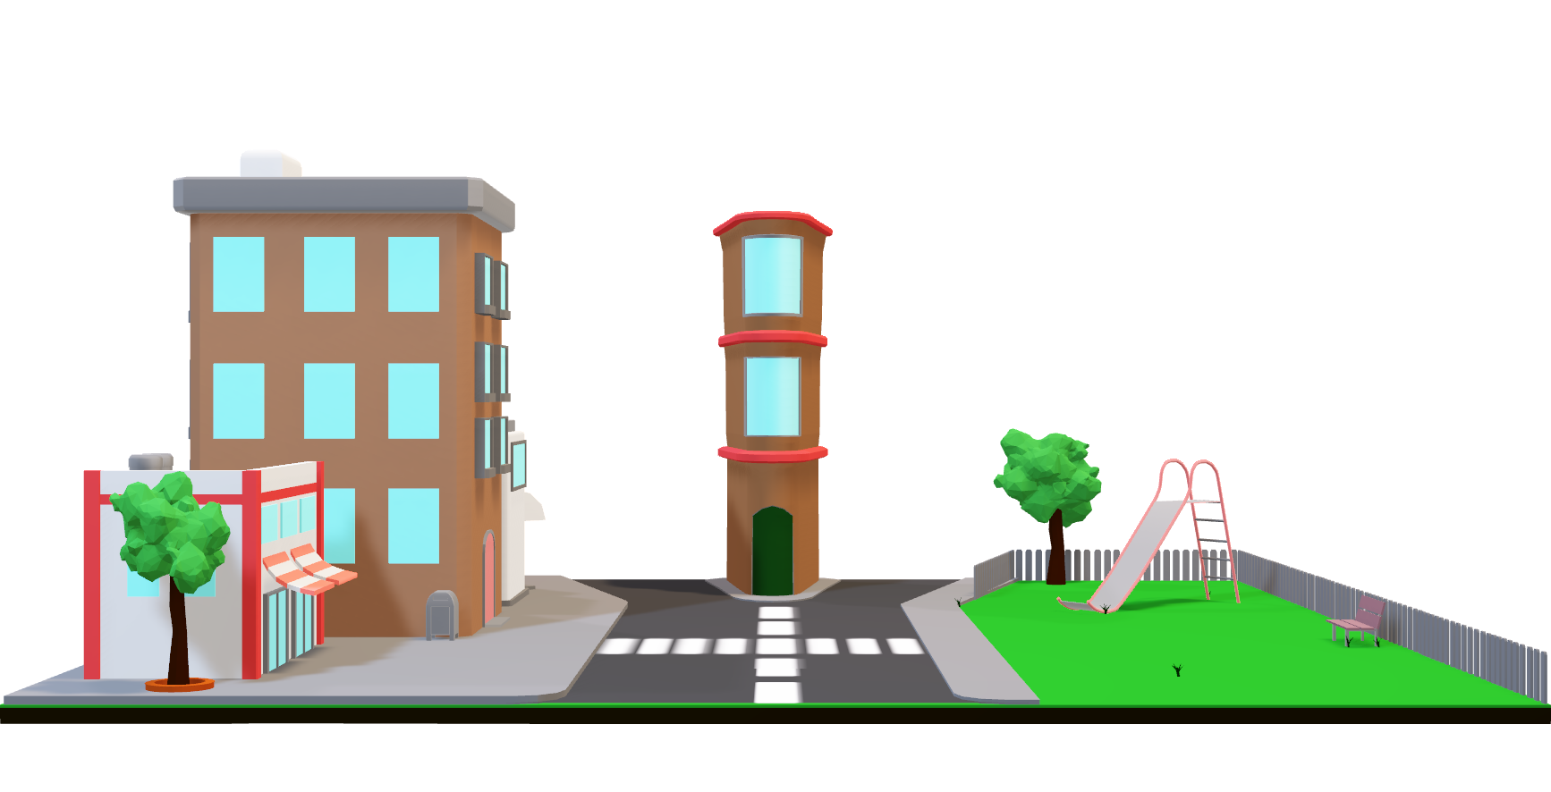
WHAT IS AN URBAN HEAT ISLAND?
An urban heat island, or UHI, is a metropolitan area that's a lot warmer than the rural areas surrounding it.
Heat is created by energy from all the people, cars, buses, and trains in big cities that have lots of activity and people.

Slide 5
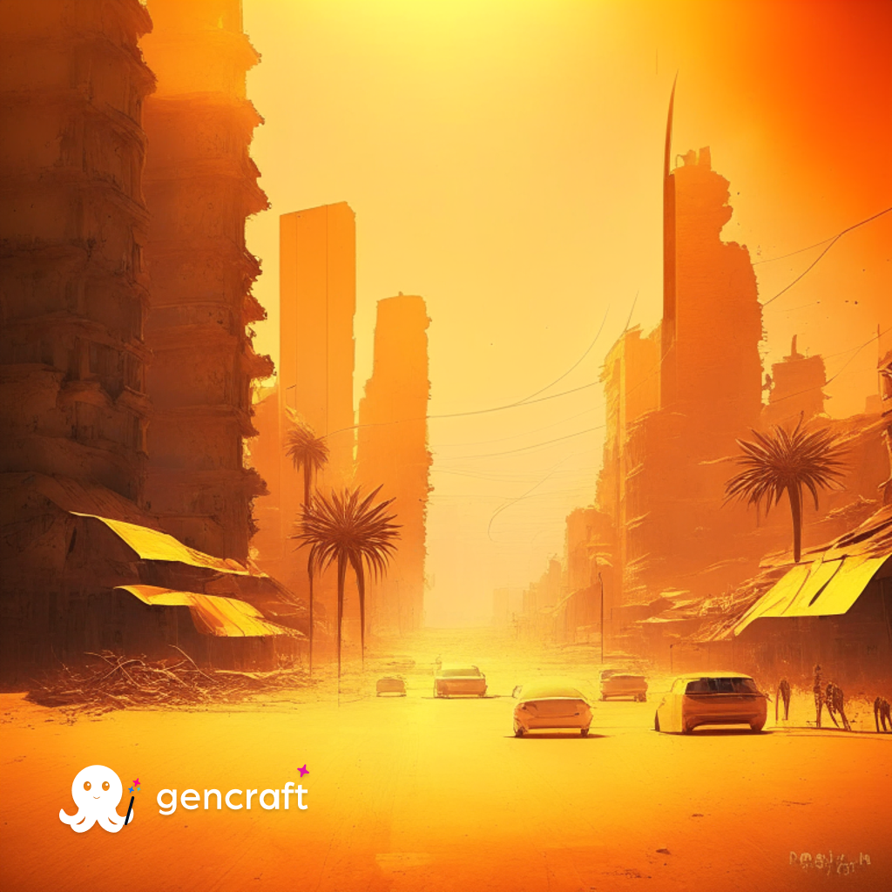

CAUSES OF UHI
When houses, shops, and industrial buildings are constructed close together, it can create a UHI. Building materials are usually very good at insulating, or holding in heat. This insulation makes the areas around buildings warmer.
"Waste heat" also contributes to a UHI. People and their tools, such as cars and factories, are always burning off energy, whether they’re jogging, driving, or just living their day-to-day lives. The energy people burn off usually escapes in the form of heat. And if there are a lot of people in one area, that's a lot of heat.

Slide 6


EFFECTS OF UHI
Nighttime temperatures in UHIs remain high. This is because buildings, sidewalks, and parking lots block heat coming from the ground from rising into the cold night sky.
UHI can have worse air and water quality than their rural neighbors. UHIs often have lower air quality because there are more pollutants being pumped into the air. These pollutants are blocked from scattering and becoming less toxic by the urban landscape.

Slide 7
UHIs contribute to energy demands in the summer, straining energy resources.
When warm water from the UHI ends up flowing into local streams, it stresses the native species that have adapted to life in a cooler aquatic environment.
Heat islands can contribute to poor air quality, magnify the impacts of extreme heat events, and put people’s health at higher risk.
THE URBAN HEAT ISLAND EFFECT ULTIMATELY CONTRIBUTES TO THE INCREASE IN AVERAGE GLOBAL TEMPERATURE, HENCE IS A FACTOR RESPONSIBLE FOR GLOBAL WARMING.

Slide 8
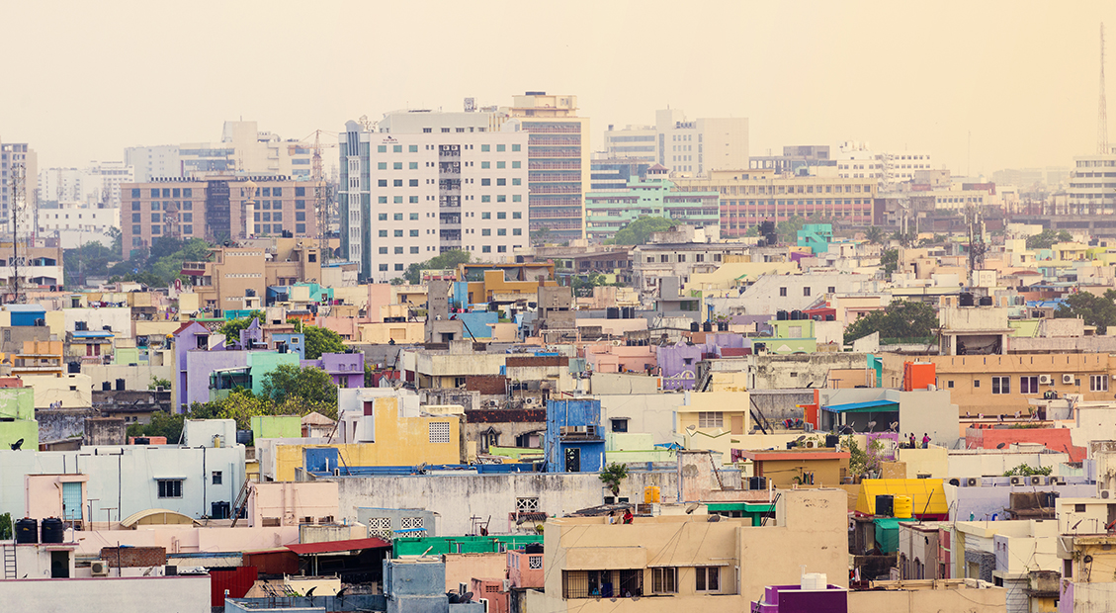
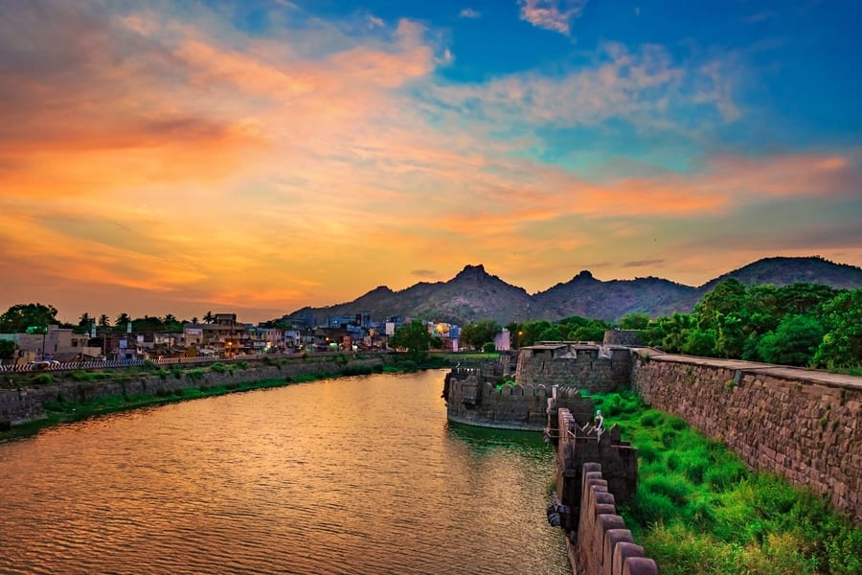
LOCATIONS CONSIDERED FOR ANALYSIS
CHENNAI
VELLORE
Chennai is the capital city of Tamil Nadu and one of the largest cities in India, with a population of over 7 million people. The city has a long history of urbanization and has undergone significant development over the past few decades. Chennai is a major economic and cultural center in South India and is home to numerous industries, educational institutions, and research centers.
Vellore is a smaller city located approximately 140 kilometers west of Chennai, with a population of around 500,000 people. While Vellore has a long history dating back to the 9th century, it has undergone less extensive urbanization compared to Chennai.

Slide 9


Overall, while both Chennai and Vellore are important cities in Tamil Nadu, Chennai is a much larger and more developed urban center, with a more extensive transportation system, diverse industries, and a larger population. Vellore, on the other hand, is a smaller city with a more focused economic and educational profile, with less extensive urbanization compared to Chennai.

Slide 10


Understanding Analysis: Key Parameters to Consider
1. SURFACE TEMPERATURE
2. VEGETATION COVER
Surface temperatures represent heat energy given off by the land, buildings, and other surfaces. Understanding the relationship between urban heat islands and surface temperature is important for monitoring and mitigating the effects of urbanization on the environment and human health.
Heat islands form as vegetation is replaced by asphalt and concrete for roads, buildings, and other structures necessary to accommodate growing populations.

Slide 11
3. Built up Index
4. AIR QUALITY
The Urban Heat Island (UHI) and the Building Urban Index (BUI) are both indicators of the urbanization process and the development of cities. The BUI is a measure of the proportion of urban built-up areas to the total land area in a given region.
UHI raises the demand for electricity in summer. Companies that supply electricity typically rely on fossil fuel power plants to meet much of this demand, which in turn leads to an increase in air pollutants and greenhouse gas emissions.
Understanding the relationship between UHI and air quality is important for developing effective strategies to mitigate the impacts of urbanization on air quality.

Slide 12
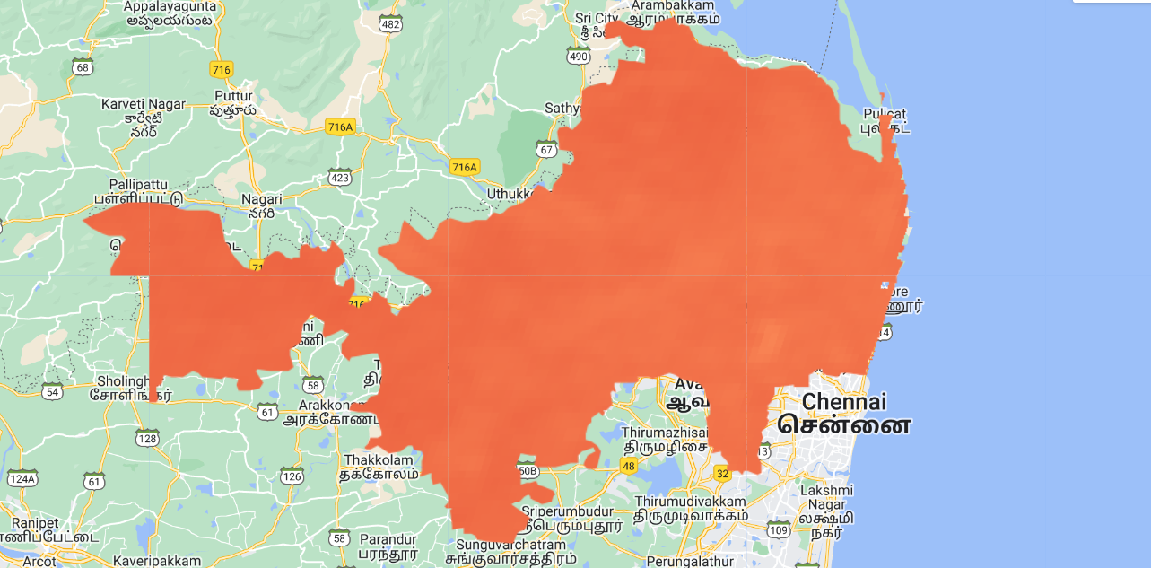
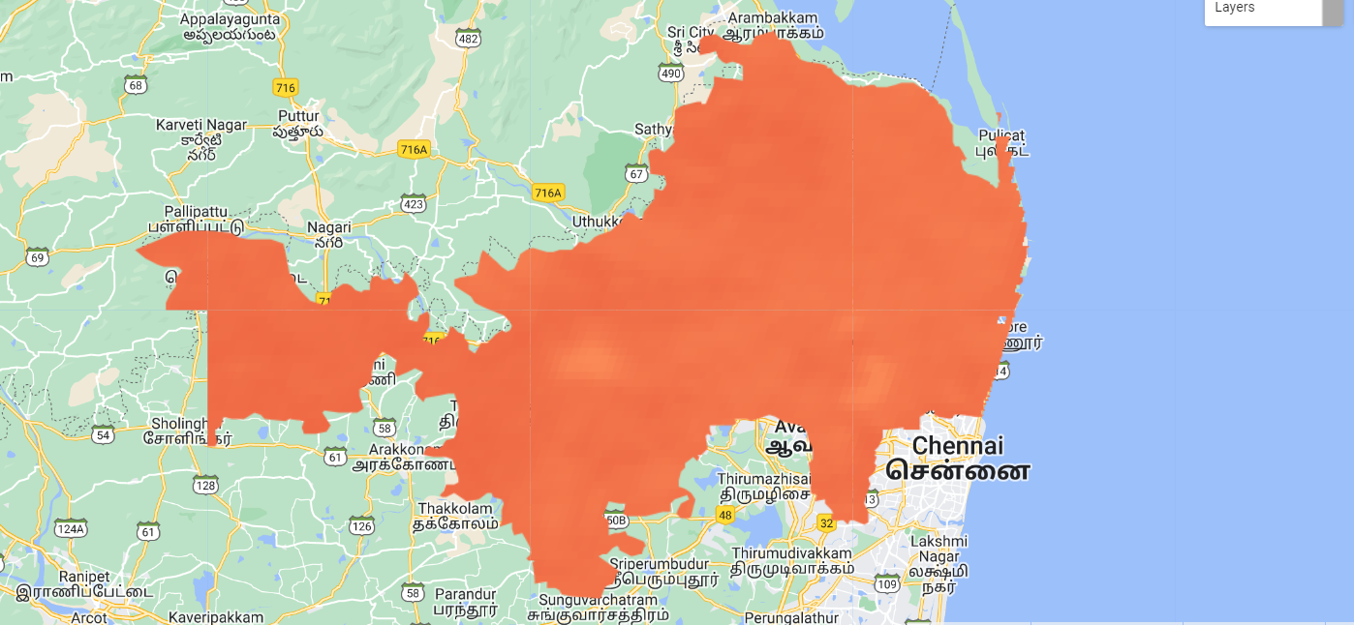

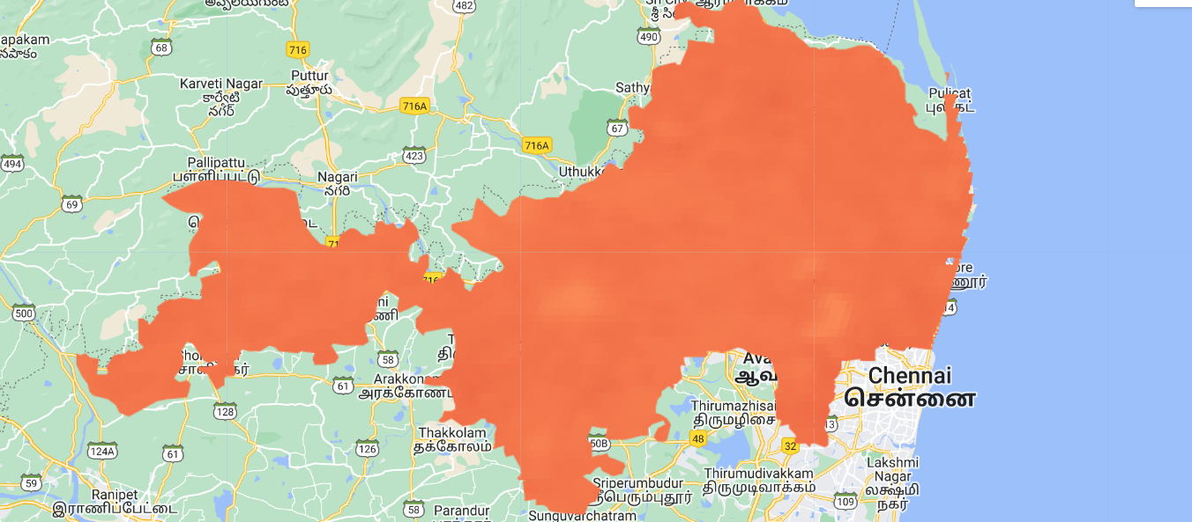
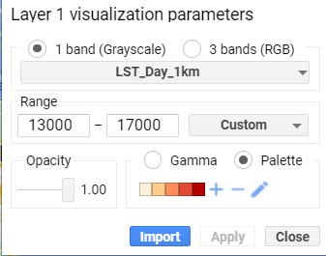
1. SURFACE TEMPERATURE - CHENNAI
2000
2010
2022

Slide 13
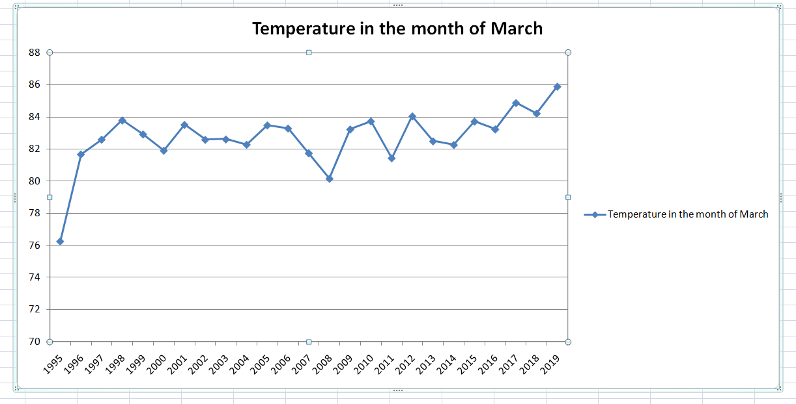

Slide 14
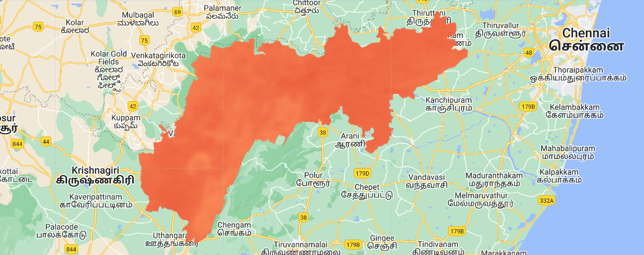
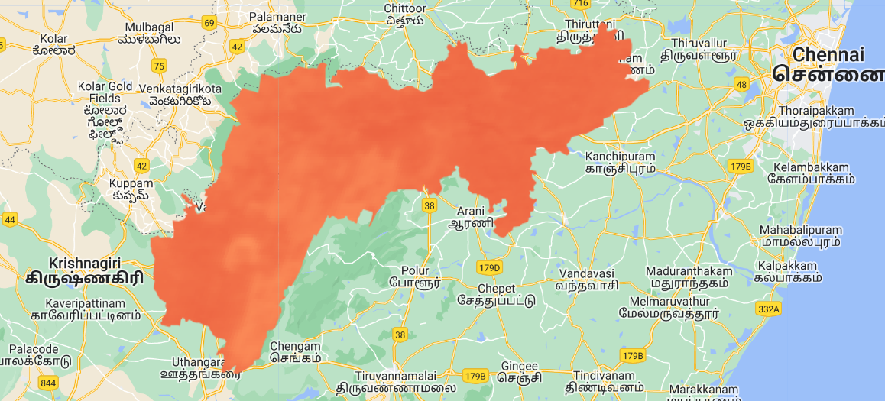
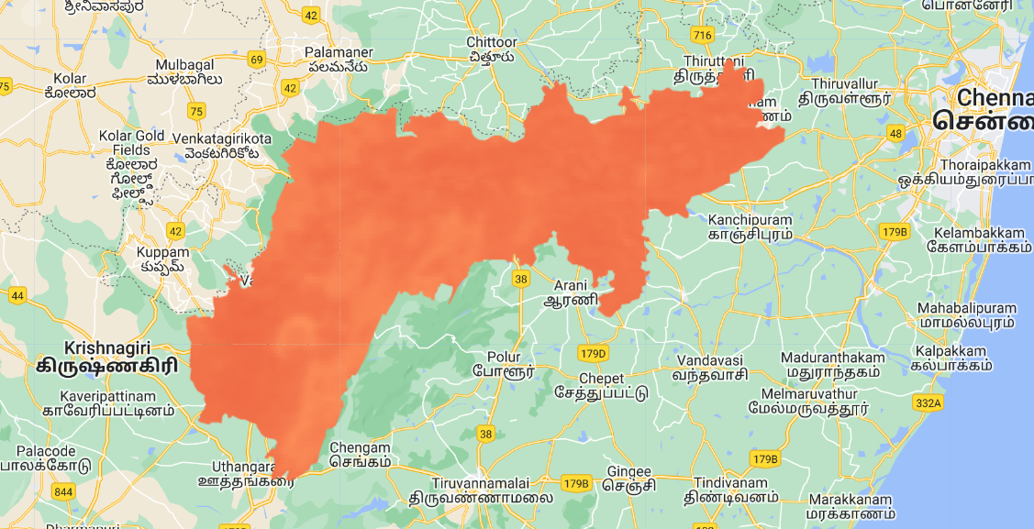
SURFACE TEMPERATURE -VELLORE
2000
2010
2022

Slide 15

INFERENCE
Temperature of Chennai as well as Vellore shows an increasing trend over the years. Due to the fast urbanization that both cities experienced during the period of study, the UHI effect has grown in both cities.
UHI effect is greater in Chennai: Compared to Vellore, Chennai is a larger and more developed urban centre, hence the UHI effect is greater there. As a result, Chennai's temperature is higher than Vellore's.

Slide 16
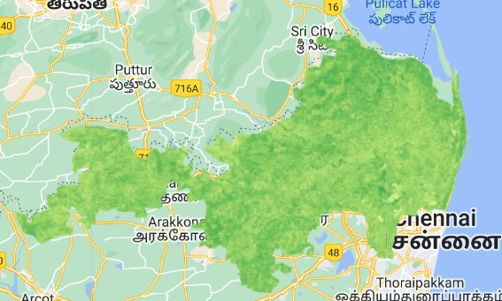
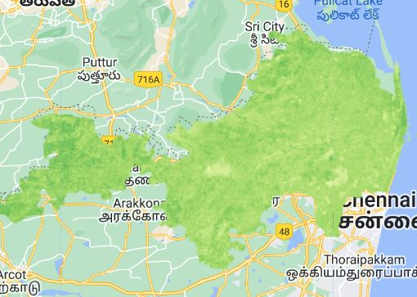
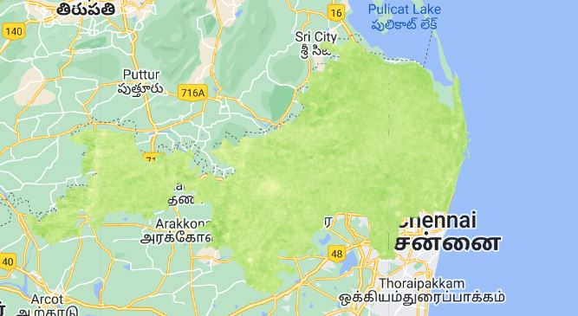
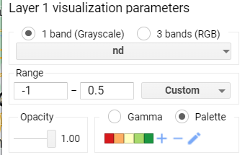
2. Vegetation cover- Chennai
2000
2010
2022

Slide 17
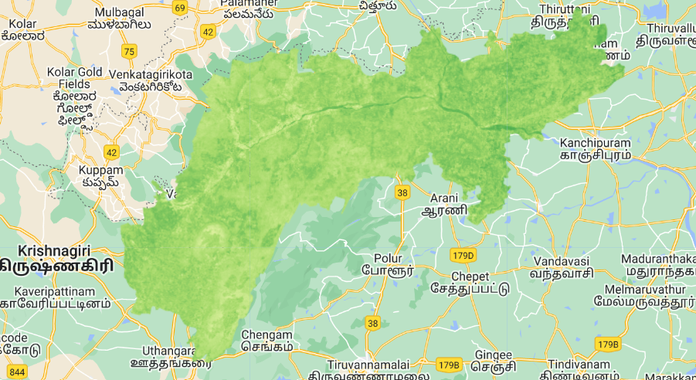
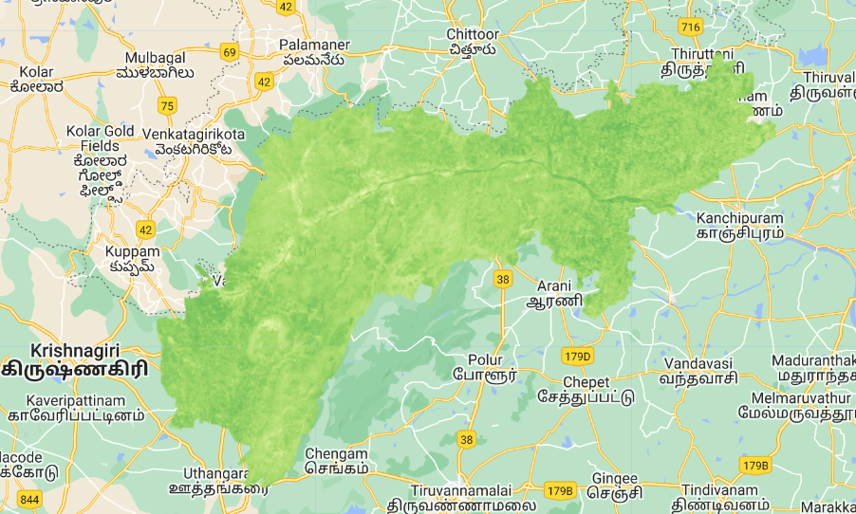
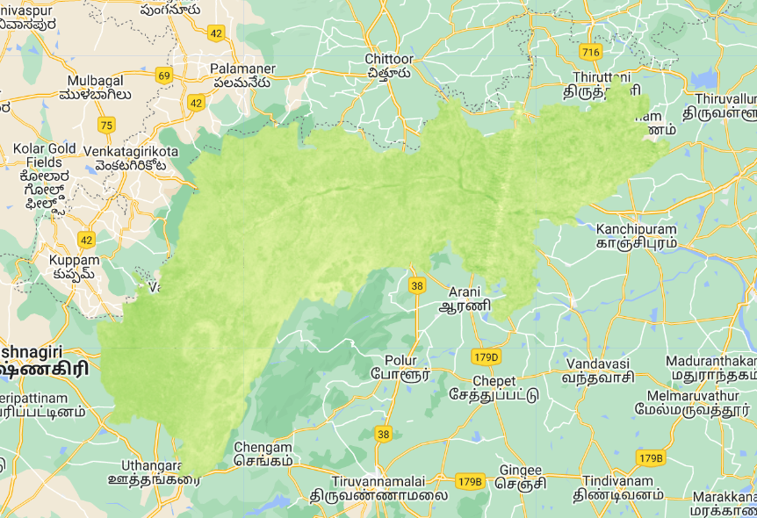
2. Vegetation cover-Vellore
2000
2010
2020

Slide 18
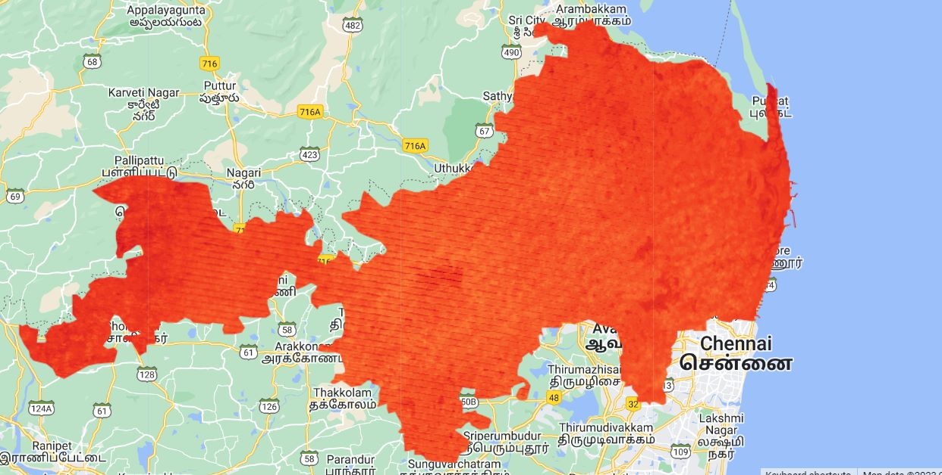
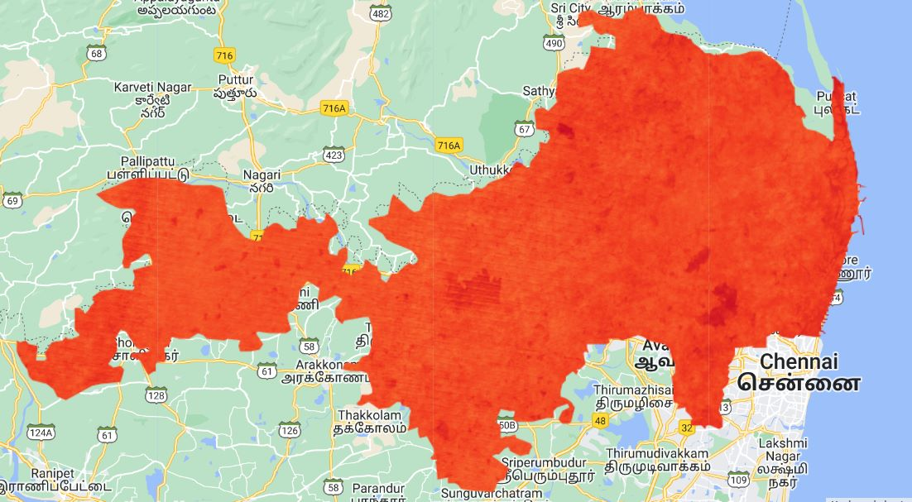
3. Built up index - Chennai
2010
2020

Slide 19
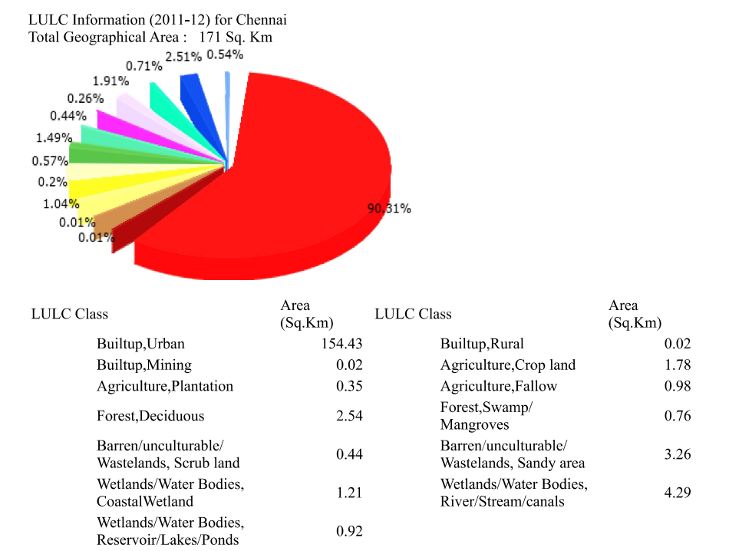
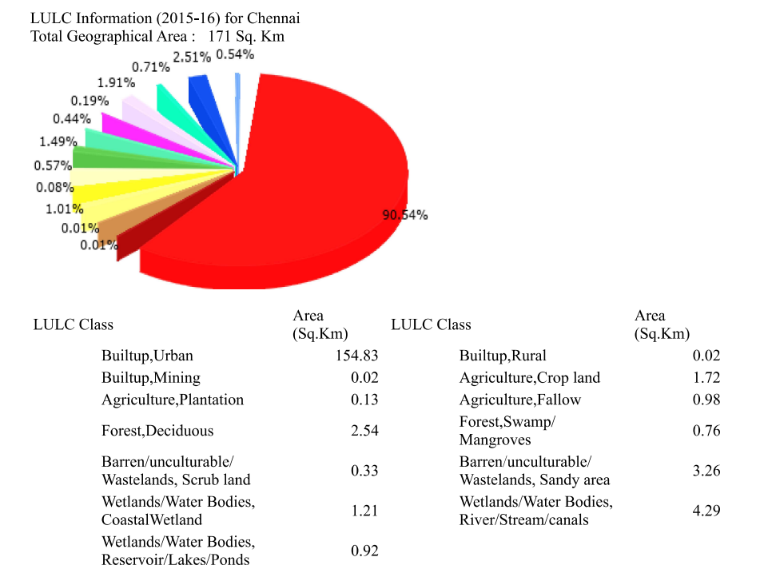

Slide 20
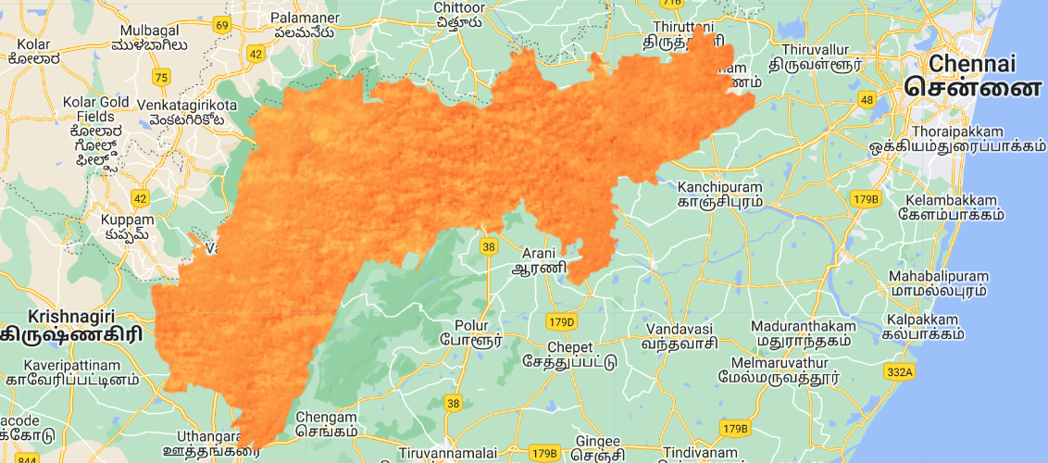
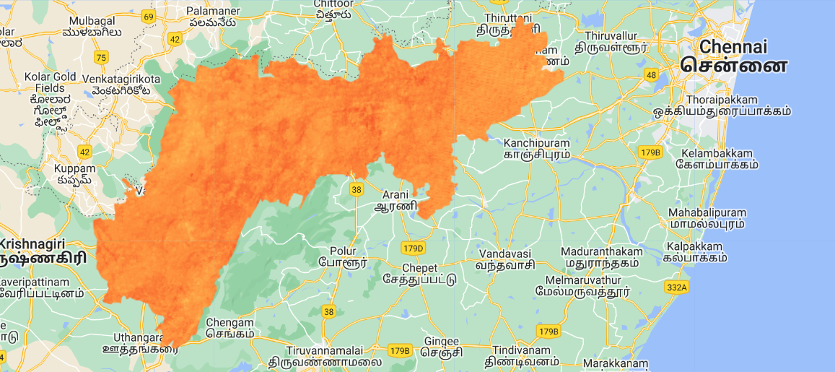
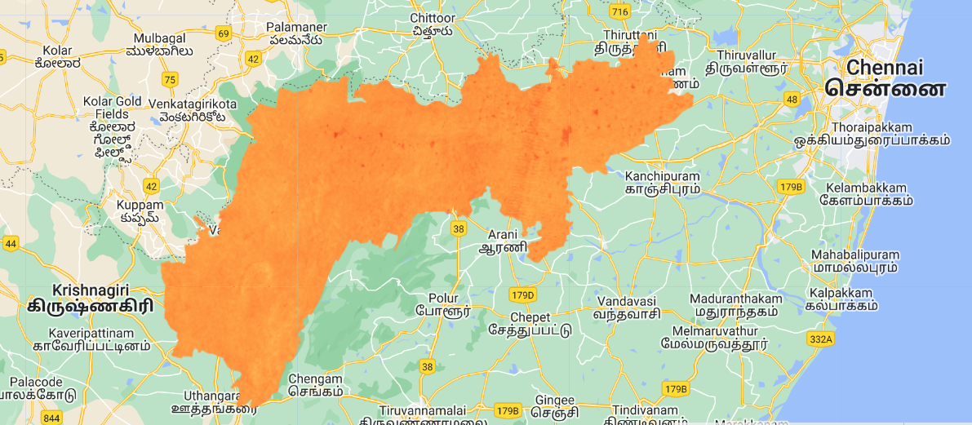
3. Built up index -Vellore
2000
2010
2022

Slide 21

INFERENCE
From 2000 to 2022, a decrease in vegetative cover in Chennai can be observed from the above images , with NDVI Varying between 0.7 (indicated by Dark green) to 0 (Indicated by Lighter green).
Heat islands form as vegetation is replaced by asphalt and concrete for roads, buildings, and other structures. Hence the above observations show that the increasing temperature of Chennai can be due to the formation of an Urban Heat Island.
On comparing Chennai and Vellore in terms of Vegetation cover and BUI, it’s obvious that there is a relationship between UHI and BUI, as urban areas with a higher proportion of built-up areas tend to have a stronger UHI effect. This is because buildings and other infrastructure have a higher thermal mass compared to natural vegetation and soil, leading to a higher absorption and retention of heat. Additionally, the increased density of built-up areas can lead to a reduction in green spaces(vegetation), which can further exacerbate the UHI effect.

Slide 22
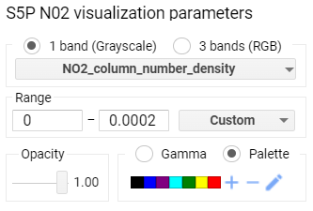
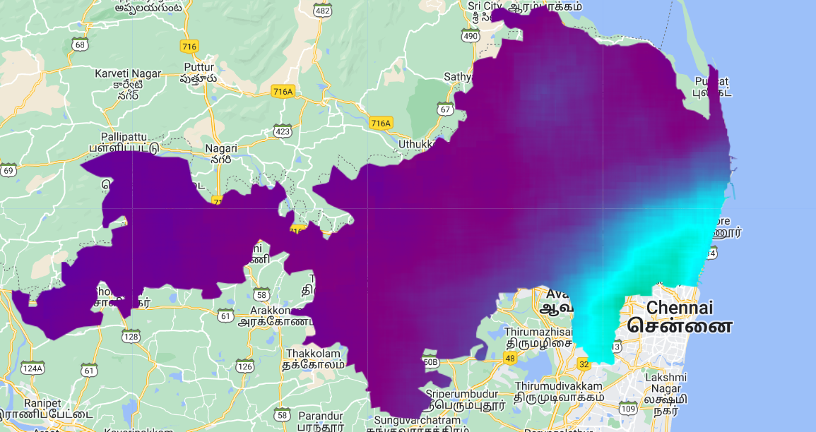
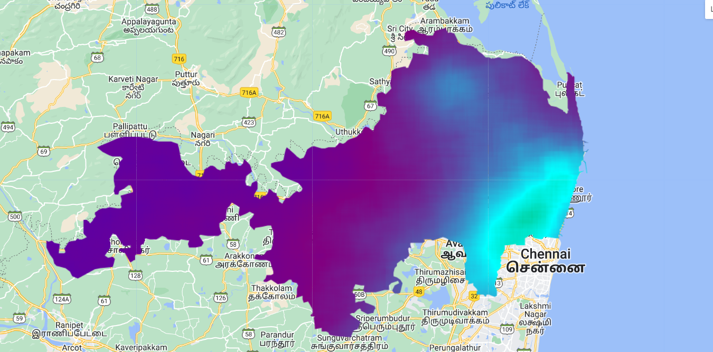
4) Air Quality - Chennai
2018
2022
4) Air Quality

Slide 23
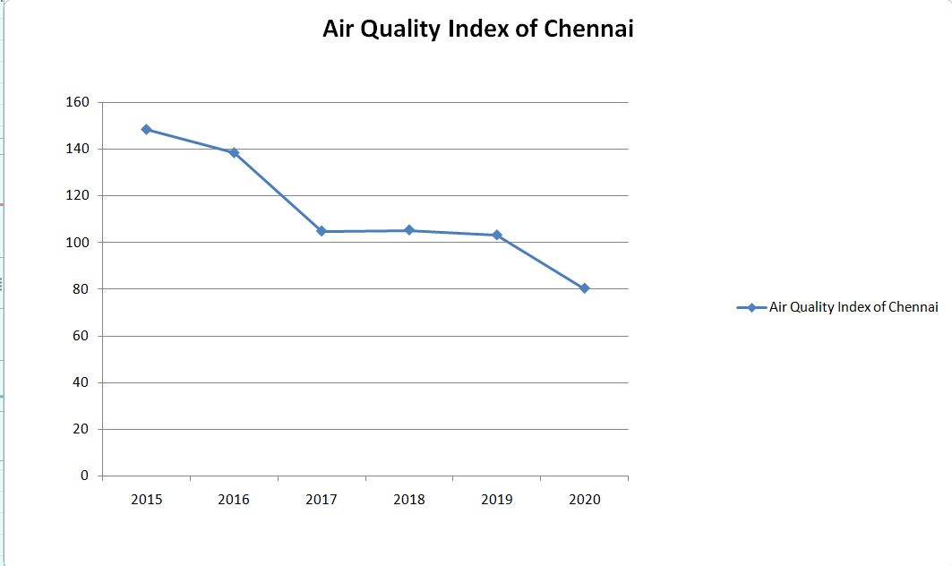

Slide 24
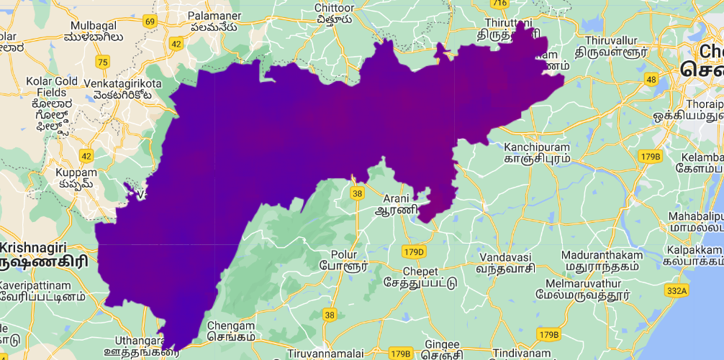
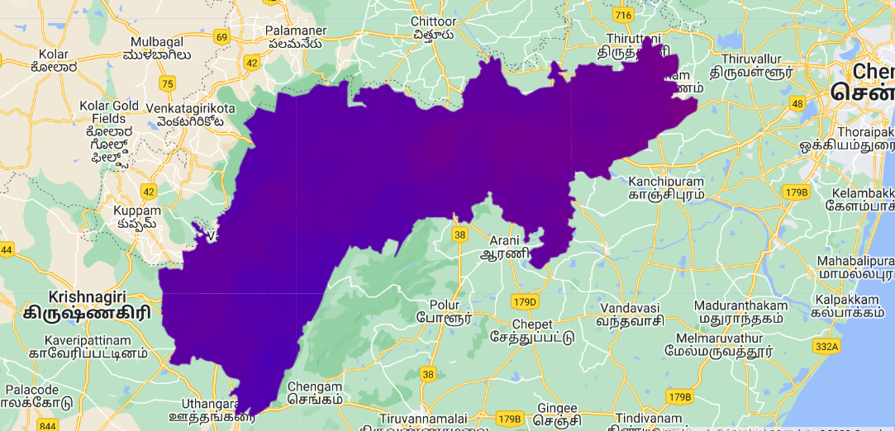
Air Quality - Vellore
2018
2022

Slide 25

INFERENCE
It is clearly visible that Chennai district is highly polluted and the air quality is deteriorating over the past few years. Vellore on the other hand has relatively better Air quality. This might be due to following reasons
1. The pace of chemical reactions in the atmosphere may accelerate as temperatures rise as a result of the UHI effect, producing pollutants like ground-level ozone and particulate matter. A layer of warm air traps pollutants near the ground during thermal inversions, which are another effect of the increasing heat and exacerbate air pollution.
2. Through modifications to the local meteorological circumstances, the UHI effect may have an indirect impact on air quality. For instance, the UHI effect can influence wind patterns, atmospheric stability, and precipitation patterns, all of which can have an impact on how pollutants are transported and dispersed in the atmosphere.

Slide 26
CONCLUSION
The effects of UHI on surface temperature, air quality, vegetation cover, and BUI were researched using two nearby districts, Chennai and Vellore, with the main difference being that Chennai is more urbanized than Vellore. It was evident that Chennai was hotter, had fewer green places, and was more polluted.
Urban heat Island effect thus gradually makes cities less comfortable to live in. Currently, the trade-offs between living in a rural area (or tier 3 city) with fewer opportunities but better air quality and ambient temperature vs living in a hot polluted city might make people choose cities, but in the long run, there is a very high possibility that people and even companies might to tier 3 cities or rural areas.

Slide 27
THANK YOU
Presented by:
AKHIL DEV M S -B200541CE
ANUSREE M A -B200567CE
RAJATH VISWAM P S -B200578CE
S BHADRA -B200528CE

